Slide 1
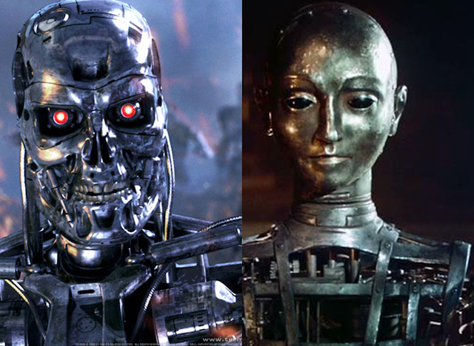
Theory Of Automata
<number>
Notes:
<number>

Slide 2
Lecture # ….
Theory of Automata
2

Slide 3
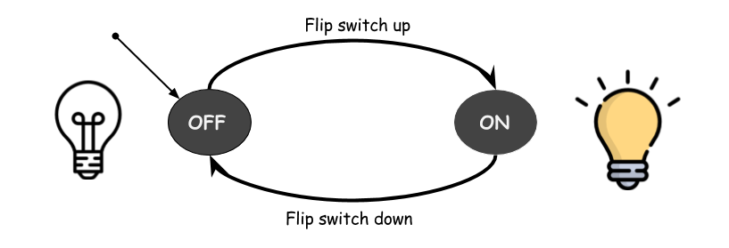
FINITE AUTOMATA
3

Slide 4
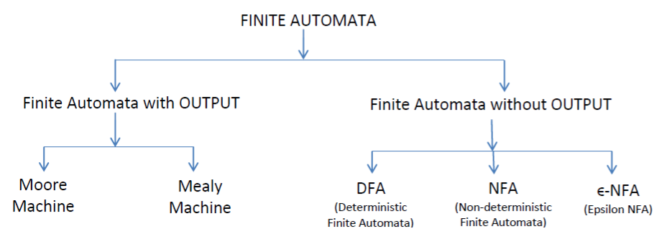
Types of Finite Automata
<number>

Slide 5
EPSILONNON DETERMINISTIC
FINITE
AUTOMATA
5

Slide 6
3:Epsilon Non Deterministic Finite Automata
*Epsilon NFA is a type of non-deterministic finite automata.
* It is finite state machine in which transition from one state to another is allowed without any input symbol (empty string)
*Adding transition for empty string doesn’t increase computing power but adds more flexibility to construct than DFA and NFA.
5

Slide 7
* It is helpful in studying Regular Expression.
* Prove equivalence between the class of language accepted by R.E and Finite Automata.
5

Slide 8
There are two ways to specify an
ϵ-NFA or ϵ-NDFA:
1) Transition Tables and
2) Directed Graphs.
(same as NFA)

Slide 9
ϵ-NFA consists of 5 tuples {Q, ∑, q, F, δ}.
Q : set of all states.
∑ : set of input symbols. ( Symbols which machine takes as input )
q : Initial state. ( Starting state of a machine )
F : set of final state.
δ : Transition Function,
defined as δ : Q X ∑ U ϵ --> 2^Q.
<number>

Slide 10
Example
ϵ-NFA
∑ = {a}
a a ϵ a
q0
q1
q2
q3
10

Slide 11
Transition Table
The indicates the start state: here q0
The * indicates the final state(s) (here only one final state q3)
STATE | INPUT a | INPUT ϵ
q0 | q1 | q0
q1 | q1 | q1 ,q2
q2 | q3 | q2
*q3 | …. | q3
11

